Slide 1
5.4 Fundamental Theorems of Asset Pricing
報告者：何俊儒

Slide 2
Introductions
Extending the discussions of above sections to the case of multiple stocks driven by multiple Brownian motions
Developing and illustrating the two fundamental theorems of asset pricing
Giving the precise definitions of the basic concepts of derivative security in continuous-time models

Slide 3
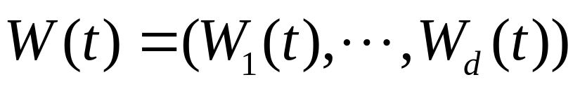
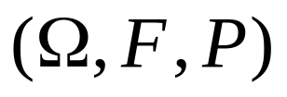
5.4.1 Girsanov and Martingale Representation Theorems
Throughout this section,
is a multidimensional Brownian motion on a probability space .
Note that:
  P is the actual probability measure
  Associated with this Brownian motion, we have a filtration F(t)

Slide 4

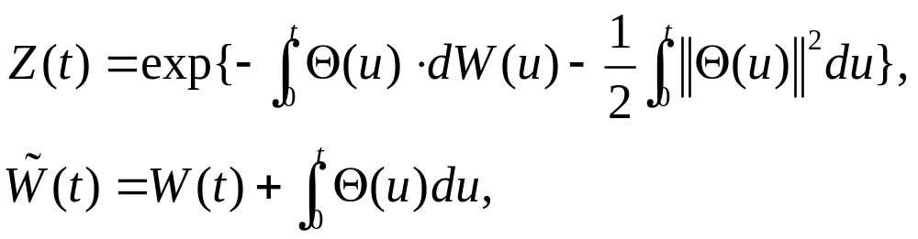
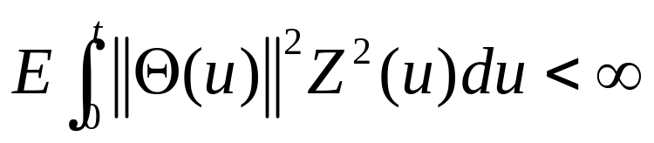
Theorem 5.4.1 (Girsanov, multiple dimension)
Let T be a fixed positive time, and let
be a d-dimensional adapted process. Define
and assume that
(5.4.1)

Slide 5

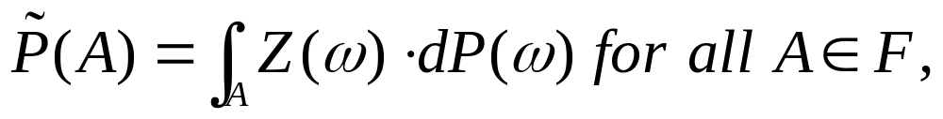
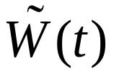
Theorem 5.4.1 (Girsanov, multiple dimension)
Set Z = Z(t). Then E(Z) = 1, and under the probability measure given by
the process is a d-dimensional Brownian motion

Slide 6
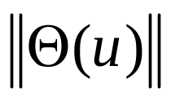
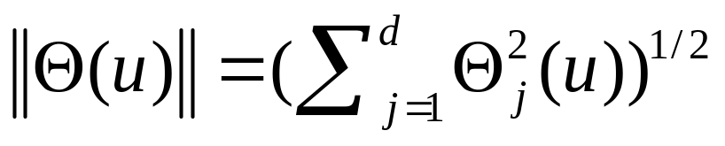
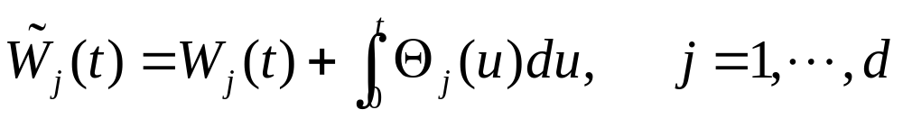
Remark of the Theorem 5.4.1
The Ito integral in (5.4.1) is
In (5.4.1), denotes the Euclidean norm
(5.4.2) is shorthand notation for
with

Slide 7
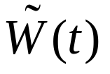


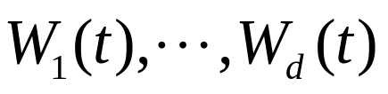


The conclusions of the multidimensional Girsanov Theorem
The component process of are independent under
  The component process of are independent under P, but each of the processes can depend in a path-dependent, adapted way on all of the Brownian motions
  Under P, the components of can be far from independent, however, after the change to the measure , these components are independent
The proof of Theorem 5.4.1 is like that of the one-dimensional Girsanov Theorem

Slide 8





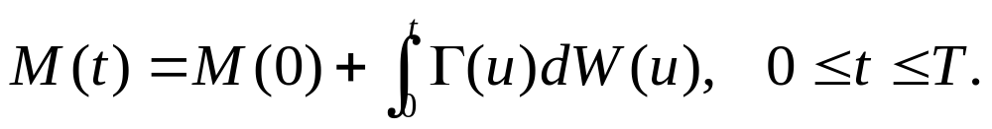
Theorem 5.4.2
(Martingale representation, multiple dimensions )
Let T be a fixed positive time, and assume that F(t), is the filtration generated by the d-dimensional Brownian motion W(t), Let M(t), be a martingale with respect to this filtration under P. Then there is an adapted, d-dimensional process
such that

Slide 9


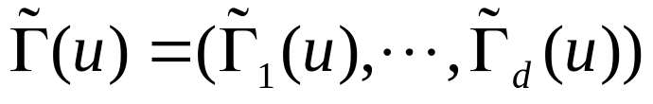
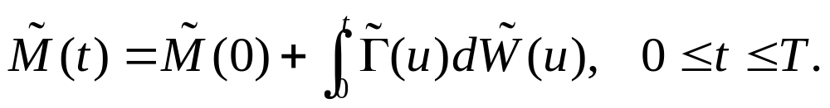
Theorem 5.4.2
(Martingale representation, multiple dimensions )
If, in addition, we assume the notation and assumptions of Theorem 5.4.1 and if is a -martingale, then there is an adapted, d-dimensional process such that

Slide 10

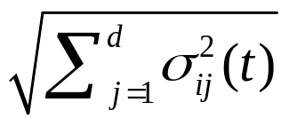
5.4.2 Multidimensional Market Model
We assume there are m stocks, each with stochastic differential
Assume that the mean rate of return and the volatility matrix are adapted process.
These stocks are typically correlated
To see the nature of this correlation, we set
which we assume is never zero
(5.4.6)

Slide 11
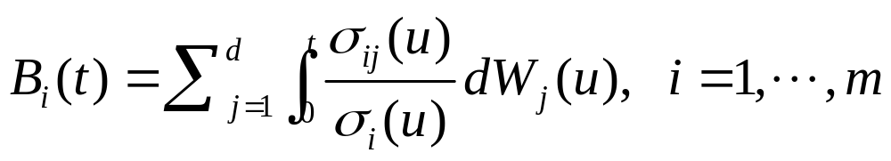
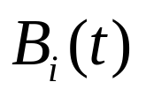
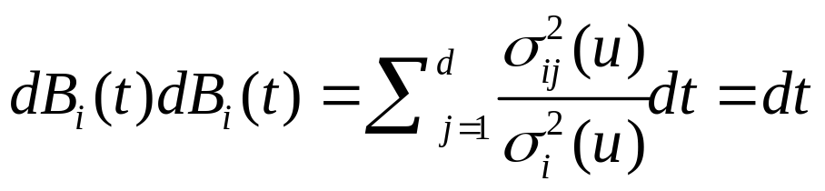
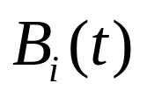
We define processes
Being a sum of stochastic integrals, each is a continuous martingale . Furthermore,
According to Levy’s Theorem, is a Brownian motion

Slide 12
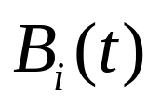



Rewriting (5.4.6) in terms of the Brownian motion as
For the Brownian motion and are typically not independent

Slide 13
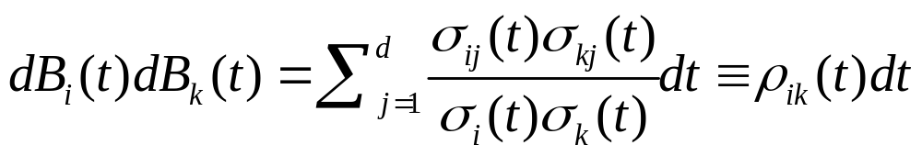
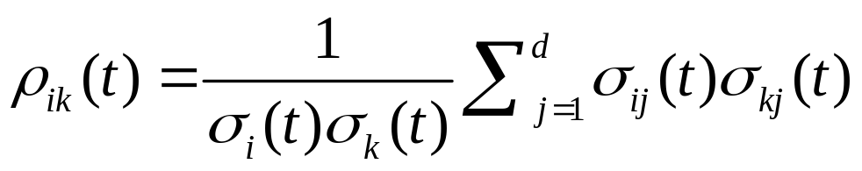
To see this, we first note that
where
Ito’s product rule implies
and integration of this equation yields

Slide 14
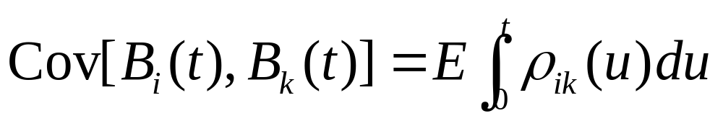
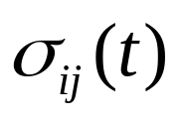
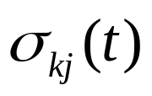
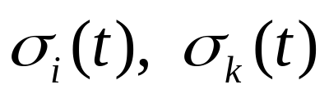
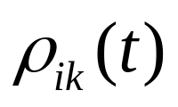
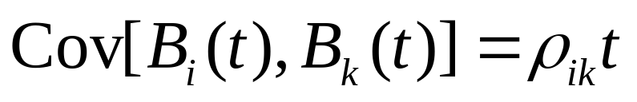
Covariance formula
Taking expectations and using the fact that the expectation of an Ito integral is zero, we obtain the covariance formula
If the process and are constant, then so are and .Therefore (5.4.12) reduces to
(5.4.12)

Slide 15

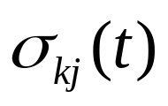
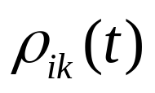

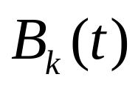
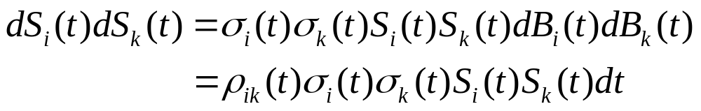
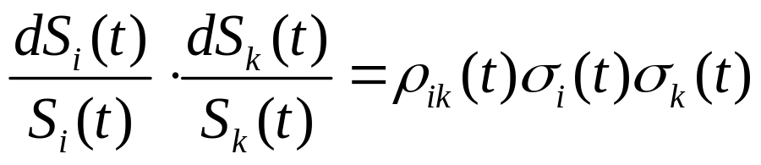
When and are themselves random process, we call the instantaneous correlation between and
Finally, we note from (5.4.8) and (5.4.9) that
Rewriting (5.4.13) in terms of “relative differential,” we obtain
(5.4.13)

Slide 16
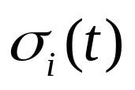
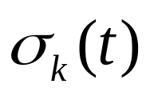


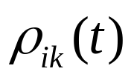
The volatility process and are the respective instantaneous standard deviations of the relative changes in and at time k
The process is the instantaneous correlation between these relative changes
However, standard deviations and correlations can be affected by a change of measure when the instantaneous standard deviations and correlations are random

Slide 17
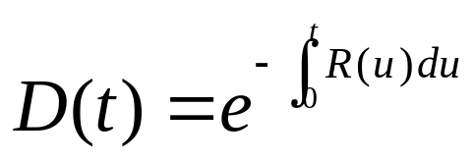
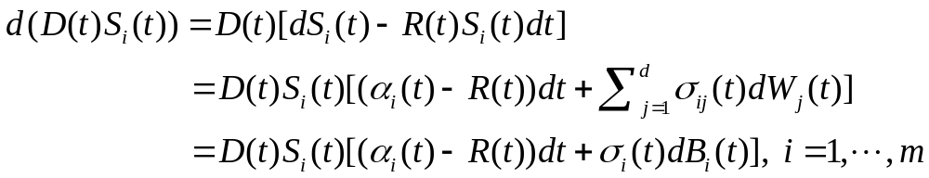
Discount process of stocks
We define a discount process
We assume that the interest rate process R(t) is adapted
Besides the stock prices, we shall often work with discounted stock prices and their differentials are
(5.4.15)

Slide 18


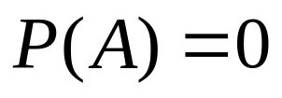
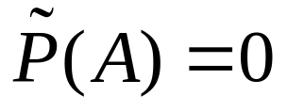

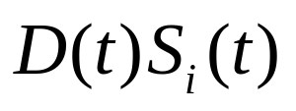
5.4.3 Existence of the Risk-Neutral Measure
Definition 5.4.3
A probability measure is said to be risk-neutral if
  (i) and are equivalent (i.e., for every
  and if and only if )
  (ii) under , the discounted stock price is a martingale for every i = 1, …, m

Slide 19
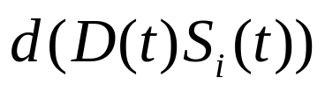
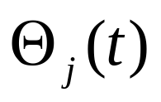
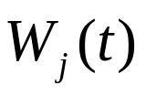
To make the discounted stock prices be martingales, we rewrite as
If we can find the market price of risk processes that make (5.4.16) hold, with one such process for each source of uncertainty we can then use the multidimensional Girsanov Theorem to construct an equivalent probability measure
(5.4.16)

Slide 20
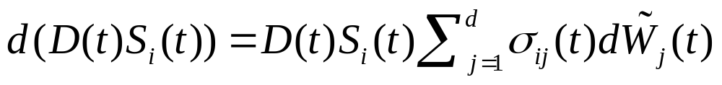
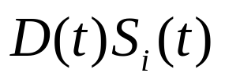

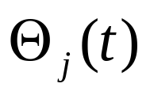
This permits us to reduce (5.4.16) to
And hence is a martingale under
The problem of finding a risk-neutral measure is simply one of finding processes that make (5.4.15) and (5.4.16) agree

Slide 21
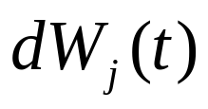
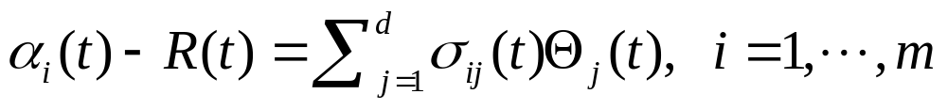
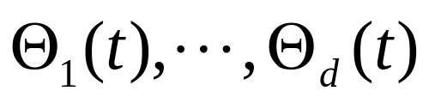
Since these equations have the same coefficient multiplying each , they agree if and only if the coefficient multiplying dt is the same in both case, which means that
We call these the market price of risk equations where are in the d unknown processes

Slide 22



Example 5.4.4
Suppose there are two stocks (m = 2) and one Brownian motion (d = 1), and suppose futher that all coefficient processes are constant
Then, the market price of risk equations are
These equations have a solution if and only if

Slide 23


Example 5.4.4 (conti.)
If this equation doesn’t hold, then one can arbitrage one stock against the other
Suppose that
and define

Slide 24



Example 5.4.4 (conti.)
Suppose that at each time an agent holds
  Stock one:
  Stock two:
  Money market account: at the interest rate r
to set and maintain this portfolio
The initial capital required to take the stock positions is and to set up the whole portfolio, including the money market position, is X(0) = 0

Slide 25


Example 5.4.4 (conti.)
The differential of the portfolio value X(t) is
The differential of the discounted portfolio value is
where is strictly positive and nonrandom

